Slide 1
Chapter 8
Paired-Sample t-Test

Slide 2
Learning Objectives
Explain the concept of paired-sample t-test
Describe the main assumptions and design considerations for the paired-sample t-test
Describe the statistical significance of the paired-sample t-test
Formulate a research problem and a design hypothesis for the paired-sample t-test
Describe the concept of one-tailed and two-tailed conditions

Slide 3
Demonstrate the steps used in SPSS to execute the paired-sample t-test
Explain how to analyse and interpret the SPSS outputs
Describe the formulae and calculations of the paired-sample t-test
Report the final results of the paired-sample t-test
Explain how to use the one-sample t-test for the scores obtained in paired difference

Slide 4
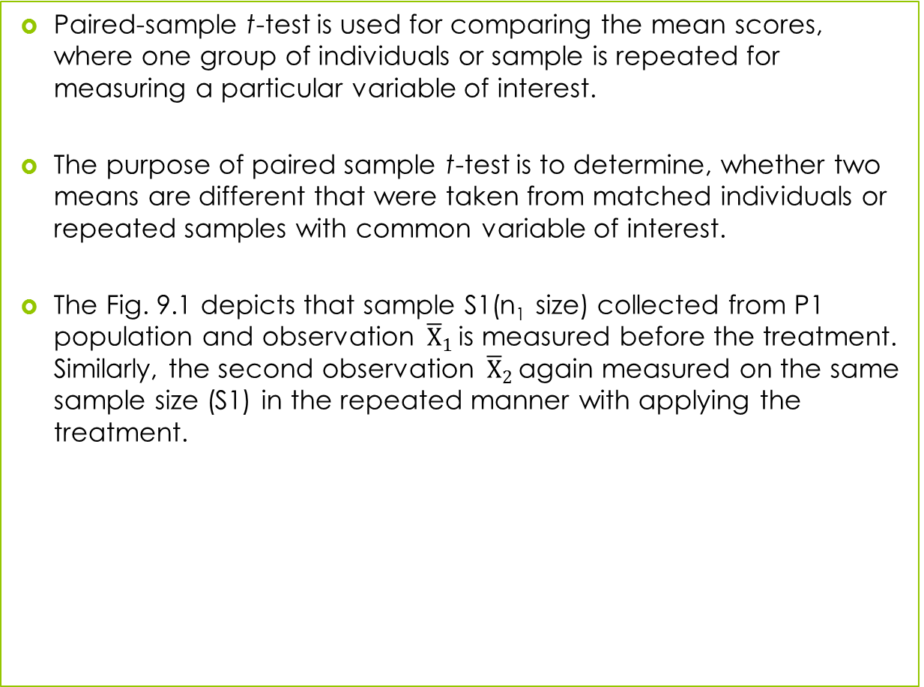
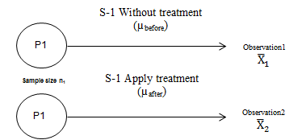
Introduction

Slide 5
Assumptions for Paired-Sample t-Test
Designing experiment: Consideration of pairs and respective measurement are the important criteria to design experiment in paired-sample t-test. A single group consists of cases or subjects and the measurement before and after the treatment could be applied to generate the results.
Variability between paired data: A paired-sample t-test is appropriate with the observations of distinct and large variability between the experiment groups.

Slide 6
Differences of paired data: The data used in paired-sample t-test is actually the differences between the paired samples that are measured at ratio or interval scale.
Normality of differences: The basic assumption affecting the validity of results is the normal distribution of difference scores of the target pairs that represent a random sample of the population of the differences.

Slide 7
Summary of Assumptions
Table 8.1. Assumptions for Paired-sample t-Test
Assumptions | Examine Approach | Measures/Tests
Pair or matched sample | Methodological | –
Variability between paired data | Numerical method | Paired-sample correlation coefficient
Differences of paired data | Methodological (Interval or ratio scale of measurement) | –
Normality of differences | Graphical method | Histogram, Box and whisker plot
 | Numerical method | Skewness and kurtosis
 |  | KS one sample and Shapiro–Wilk

Slide 8
Framing Hypotheses
Hypothesis for two-tailed condition: The two-tailed test is used to investigate the difference in mean score either in lower or upper tail of the normal distribution.
Null hypothesis H₀: µ_{before}= µ_{after}
(Mean scores before and after the treatment are same.)
Alternative hypothesis H_{a}: µ_{before} ≠ µ_{after}
(Mean scores before and after the treatment are not same.)

Slide 9
Hypothesis for one-tailed condition: When we are interested in detecting the difference of mean scores in a particular direction of interest (either increase or decrease).
Null hypothesis H₀: µ_{before} = µ_{after}
(Mean scores before and after the treatment are same.)
Alternative hypothesis H_{a}: µ_{before} > µ_{after}
(Mean score before the treatment is greater than after.)
H_{a}: µ_{before} < µ_{after}
(Mean score before the treatment is lower than after.)

Slide 10
Paired-Sample t-Test (Two-tailed)
Paired-sample t-test with two-tailed condition determines the significant mean difference between two related observations at different points of time and are obtained from the same population.
Executing Paired-Sample t-Test with SPSS Procedure
Assessing Normality
Exhibit 8.1. Use student.sav » Transform » Compute Variable » Type the name of new variable (difference) in the box Target Variable » Select » Score before and transfer to box Numeric expression » Select the sign of minus » Select score after in same numeric expression » Click OK (check a new variable difference in the data view)

Slide 11
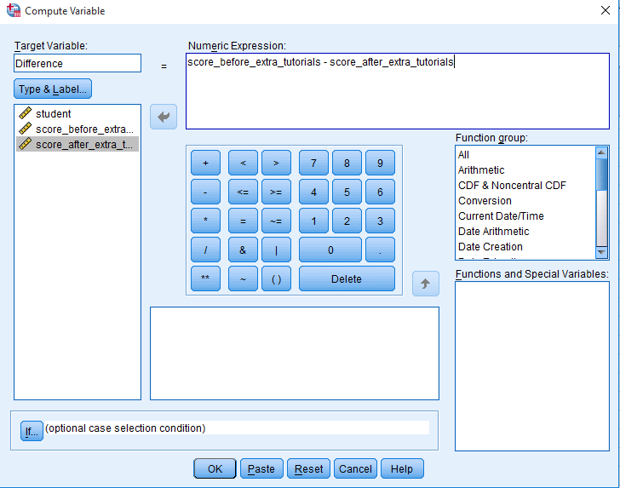
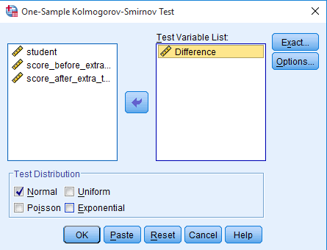
Examine the Assumptions
Exhibit 8.2. Use student.sav » Menu bar » analyse » Non-parametric test » Legacy Dialogs » One-sample KS test » Difference transfer to Test Variable(s) List » Click on Normal distribution under Test distribution » Click OK

Slide 12
Results of Assumptions
Table 8.2. Assessing Normality: One-Sample KS
 | N | Normal Parameters |  | K-S | Sig. (2-tailed)
 |  | Mean | Std. Deviation
Difference (d₁−d₂) | 30 | −3.1 | 7.36 | 0.100 | 0.200
Null hypothesis H₀: Population is normal distributed.
Alternative hypothesis H_{a}: Population is not normal distributed.

Slide 13
The p-value (Sig. (2-tailed)) as shown in the last column is used to examine the normality of paired difference. As the p-value is more than 0.05 (p > 0.05, 0.200 at 5% LoS), we fail to reject null hypothesis reflecting the condition of normality.

Slide 14
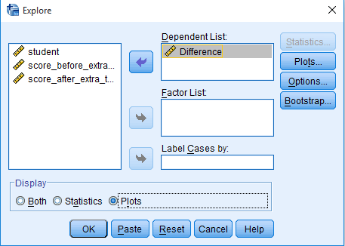
Check the Assumption of Normality Graphically
Exhibit 8.3. Use student.sav » Menu bar » analyse » Descriptive statistics » Explore » Select Differences and transfer in Dependent List box » Select Plots under Display box » Plots » Continue » Click OK

Slide 15
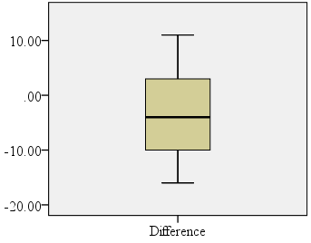
Fairly symmetric distribution of differences in scores and indicate the assumption of normality in data.

Slide 16
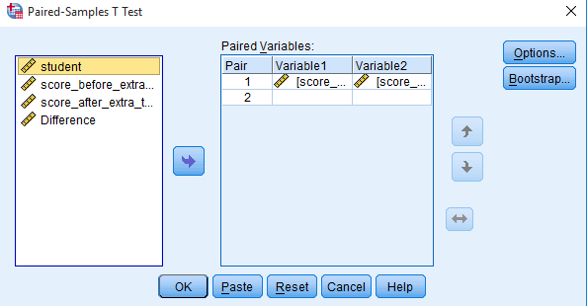
SPSS Path for Descriptive Statistics, Paired-Samples Correlation and Measure of t-Test
Exhibit 8.4. Use student.sav » analyse » Compare means » Paired-samples t-test » Select » Score before extra tutorial and transfer to Paired Variable 1 » Select Score after extra tutorial and transfer to Paired Variable 2 » Click OK

Slide 17
Interpreting Outputs of Paired-Sample t-Test
Descriptive Statistics
Table 8.3. Paired-Sample Descriptive Statistics
 |  | Mean | N | Std. Deviation | Std. Error Mean
Pair 1 | Score before extra tutorials | 51.3 | 30 | 11.13 | 2.03
 | Score after extra tutorials | 54.4 | 30 | 11.38 | 2.07

Slide 18
Paired-Sample Correlation
Null hypothesis H₀: Population correlation coefficient (ρ) is equal to zero.
Alternative hypothesis H_{a}: Population correlation coefficient (ρ) is not equal to zero.

Slide 19
Table 8.4. Paired-Sample Correlation
 |  | N | Correlation Coefficient (r) | Sig.
Pair 1 | Score before and after extra tutorials | 30 | 0.78 | 0.000
A strong and positive association (r = 0.78) exists between these two scores. As p-value appears less than the LoS (p < 0.05, p = 0.000), we reject the null hypothesis and conclude that population correlation coefficient (ρ) is not equal to zero.

Slide 20
Test Statistics
Null hypothesis H₀: µ_{before} = µ_{after}
(Mean scores before and after the tutorial are same.)
Alternative hypothesis H_{a}: µ_{before ≠} µ_{after}
(Mean scores before and after the tutorial are not same.)
Table 8.5. Paired-Sample Test Statistics
Score of Students |  | Paired Differences |  |  |  |  | t | df | Sig. (2-tailed)
 |  | Mean | Std. Deviation | Std. Error Mean | 95% Confidence Interval of the Difference
 |  |  |  |  | Lower | Upper
Pair 1 | Score before and after | −3.13 | 7.36 | 1.344 | −5.88 | −0.382 | −2.33 | 29 | 0.02

Slide 21
The negative value of mean difference (−3.31) indicates the improvement in score after the treatment.
As this interval does not include zero, there is an evidence of mean difference in the population and supports the decision for rejecting null hypothesis.
As the p-value associated with paired-sample t-test is less than (p<0.05, 0.02) 5% LoS (α), the null hypothesis of ‘no difference’ in mean score is also rejected.

Slide 22
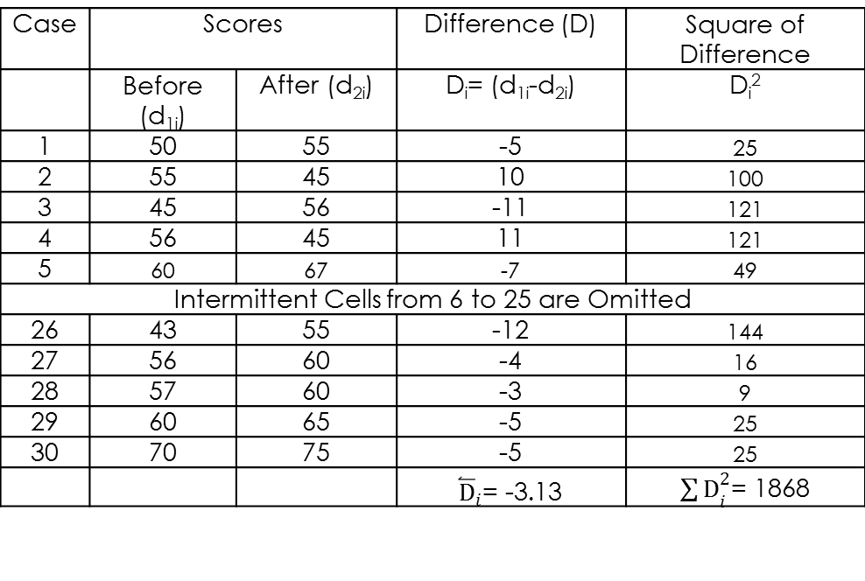
Sample Data and Important Formula for Paired-Sample Statistics
Table 8.6. Difference in Mean Scores
Case | Scores |  | Difference (D) | Square of Difference
 | Before (d_{1i}) | After (d_{2i}) | D_{i} = (d_{1i}-d_{2i}) | D_{i}²
1 | 50 | 55 | −5 | 25
2 | 55 | 45 | 10 | 100
3 | 45 | 56 | −11 | 121
4 | 56 | 45 | 11 | 121
5 | 60 | 67 | −7 | 49
Intermittent cells from 6 to 25 are omitted
26 | 43 | 55 | −12 | 144
27 | 56 | 60 | −4 | 16
28 | 57 | 60 | −3 | 9
29 | 60 | 65 | −5 | 25
30 | 70 | 75 | −5 | 25

Slide 23
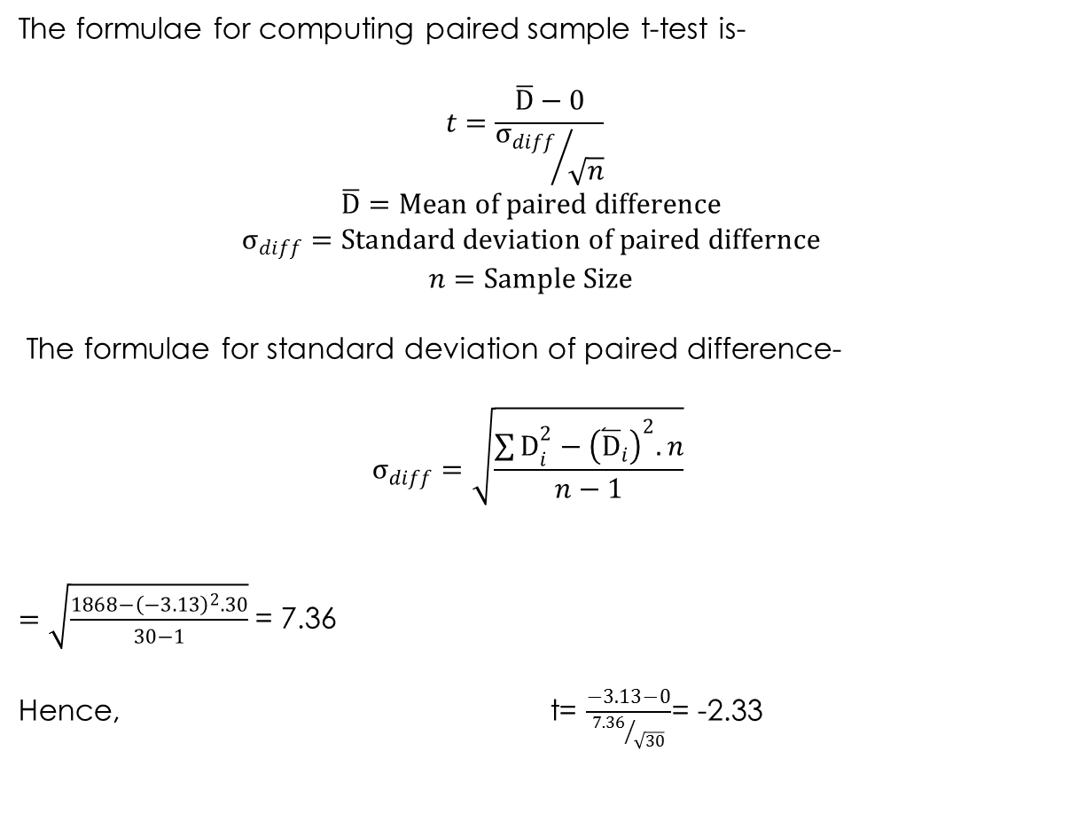

Slide 24
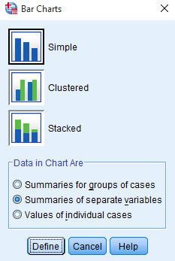
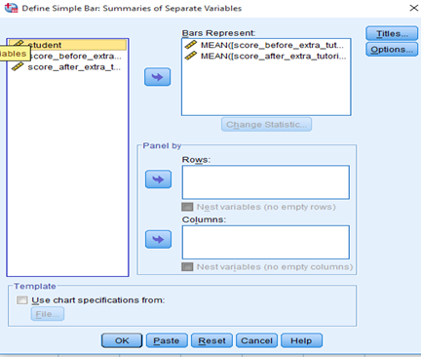
Graphical Presentation of Mean Difference
Exhibit 8.5. Use student.sav » Graphs » Legacy Dialogs » Select Bar » Select Simple bar » Select Summaries of separate variables » Transfer score before tutorial and score after tutorials in variable » Click OK

Slide 25
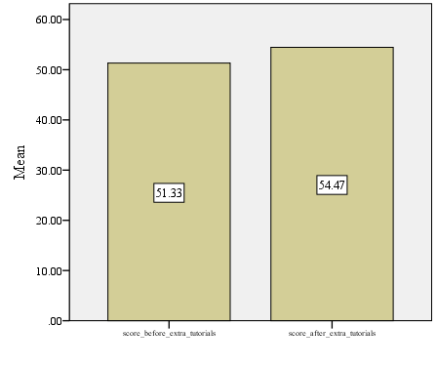
Graph
It can be observed that a difference occurs in the height of the two bars due to unequal mean scores.

Slide 26
Paired-Sample t-Test (One-tailed)
It is worth noting that practically, we are more concerned to examine whether µ₁ (before the experiment) is greater than µ₂ (before the experiment) or vice versa depending on the researchers’ idea about the direction of alternative hypothesis.
Null hypothesis H₀: µ_{d} = 0
(The mean difference is zero; the tutorials are ineffective.)
Alternative hypothesis H_{a} µ_{d} > 0
(The mean difference is positive; the tutorials are effective.)

Slide 27
Decision Rule in Paired-Sample t-Test (One-tailed)
In one-tailed condition, the p-value as computed by SPSS is divided by 2 and this modified p-value will be used for decision-making.
With continuation of previous analysis as shown in Table 8.3c, a modified p-value will be used as 0.01 after dividing the two-tailed p-value by 2 (0.02/2 = 0.01).
In this view, as the value is less than 0.05 (α level), the null hypothesis is rejected and we conclude that mean difference is positive and tutorials are effective.

Slide 28
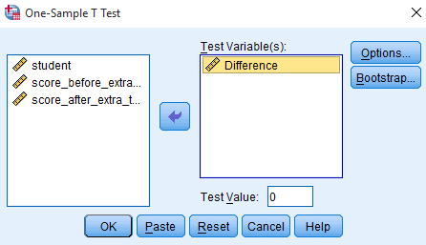
Using One-Sample t-Test for Difference Scores
We can also apply one-sample t-test to find out the statistical evidence for difference in scores (µ_{before} − µ_{after}). In this case, we examine whether the score difference equals to zero or not.
Exhibit 8.6. Use student.sav » analyse » Compare means » One-sample t-test » Select » Difference transfer to Test Variable(s) » Type 0 as test value » Click OK

Slide 29
One-Sample Test Statistics
Table 8.7. One-Sample Test Statistics
 | Test Value = 0
 | t | df | Sig. (2-tailed) | Mean Difference | 95% CI of the Difference
 |  |  |  |  | Lower | Upper
Difference | −2.33 | 29 | 0.027 | −3.13 | −5.88 | −0.382

Slide 30
It is important to note that we have assigned zero as a test value on the basis of null hypothesis.
The smaller p-value (p < 0.05, 0.027) as computed by SPSS at 5 per cent LoS leads to reject the null hypothesis of ‘zero mean difference’.
Thus, there is enough evidence to conclude that the mean difference of scores before and after tutorials are different from zero.

Slide 31
Reporting the Final Results of Paired-Sample t-Test
As the p-values associated with one-sample KS test (KS Z = 0.100, p > 0.05, 0.200) is more than 5 per cent LoS, we fail to reject the null hypothesis of normal distributed population.
The correlation is also significant due to lower p-value at 5 per cent LoS (ρ = 0.78, p < 0.05, 0.000).
As the p-value associated with t-test statistics [t (29) = −2.33, p < 0.05, 0.02)] is less than the criterion value (5% LoS), we reject the null hypothesis of equal means before and after the treatment (µ_{before}= µ_{after}).

Slide 32
Key Terms
95% confidence interval of mean Correlation coefficient Differences of Paired Data Matched pair Mean difference One-Sample t-test | Paired Sample Correlation Paired Sample Statistics Paired sample t-test Simple bar chart Two tailed and One-tailed condition Variability between Paired Data

